Slide 1


Playwright POC

Slide 2
Objectives
Automate & run few functional test cases of GW Policy Center using Playwright.
Automate & run Customized API Testing using Playwright.
Automate & run the Cloud API Testing through Integration Gateway using Playwright.
Test Data Parameterization – From External Source (Excel)
Pros & Cons
Appendix
Note: Guidewire PC version : JASPER
LoB: D&O

Slide 3
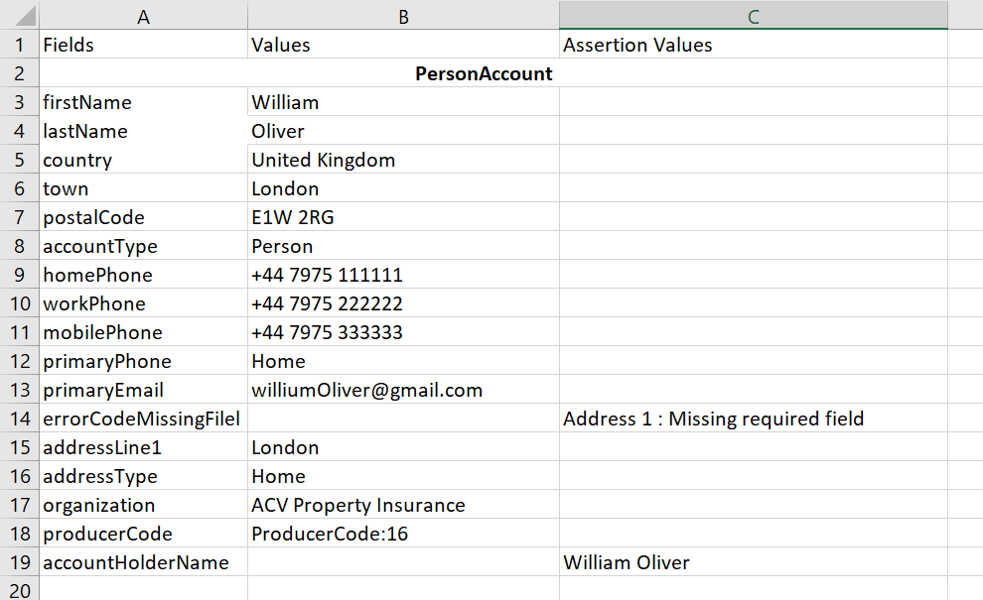
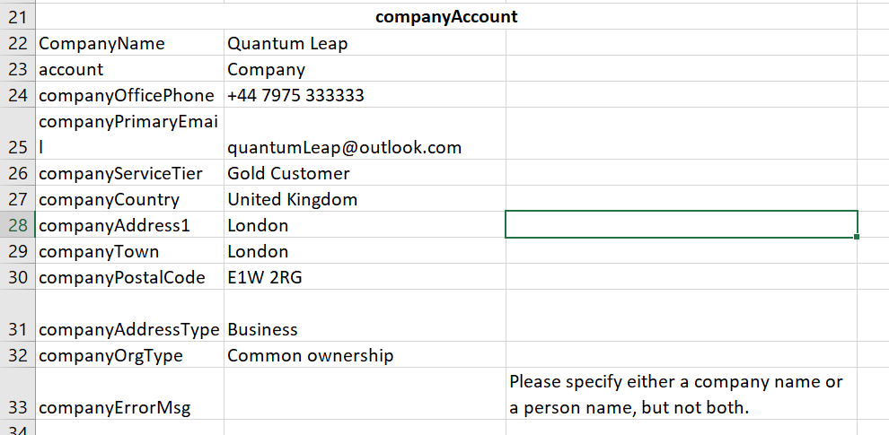
GW PC – Functionalities Validated with Playwright tool
Functionalities Tested:
Login Functionality
  Successful Login
  Failed Login
Account Creation for Person
  Account Creation with full data
  Mandatory Field Filled Check
  Name Of The Account Holder Already Exist
  Verify Exclusive Entry: Person or Company Details
Account Creation for Company
  Account Creation with UK data
  Account Creation with US data
Policy Creation for D&O insurance LOB
  Create D&O Policy(Submission, Quote, Bind and Issue)
Test Data:

Slide 4
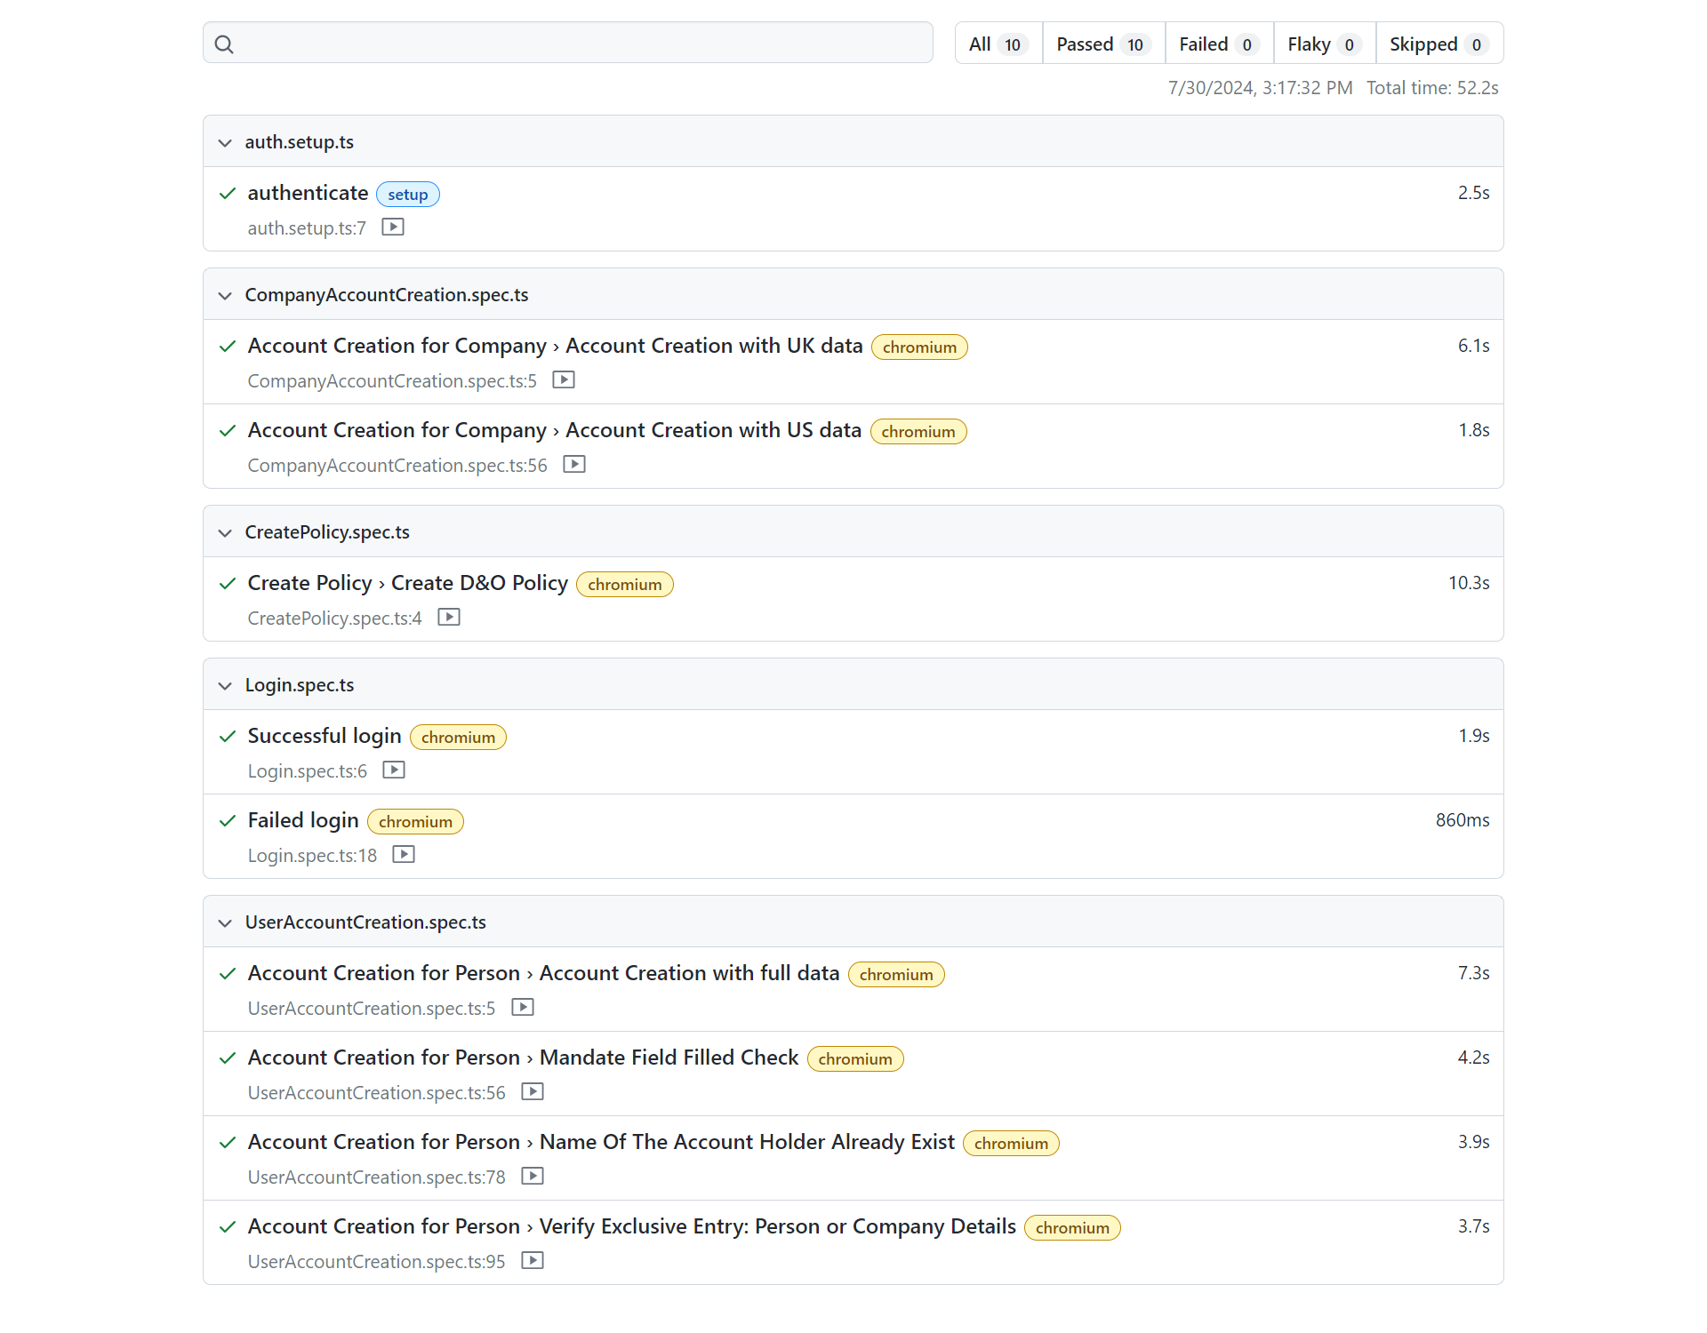
Test Execution Report
Execution Report:

Slide 5
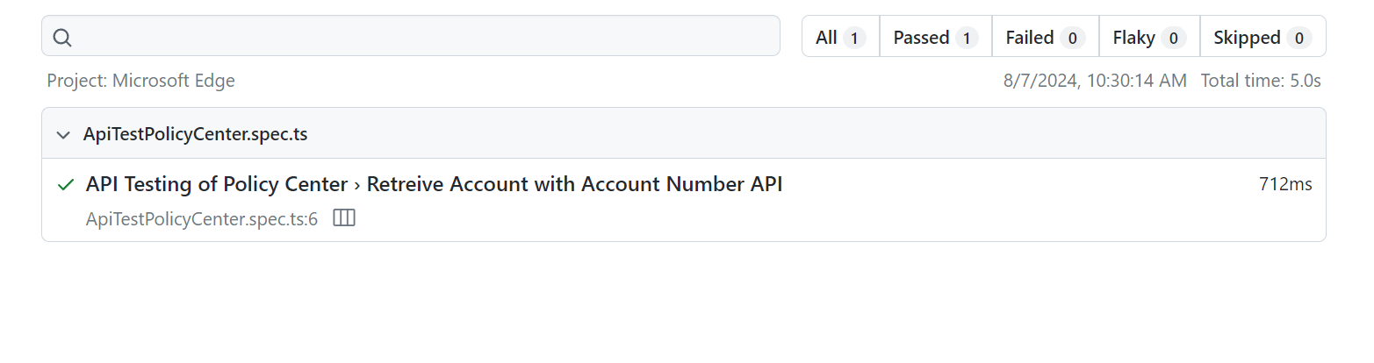
Customized API Testing with Playwright- 1
Customized API functions executed with Playwright:
Retrieve the account API
(A custom cloud API has been developed in GWPC. Playwright script was developed and executed to Retrieve to view account summary)
Execution Report:

Slide 6
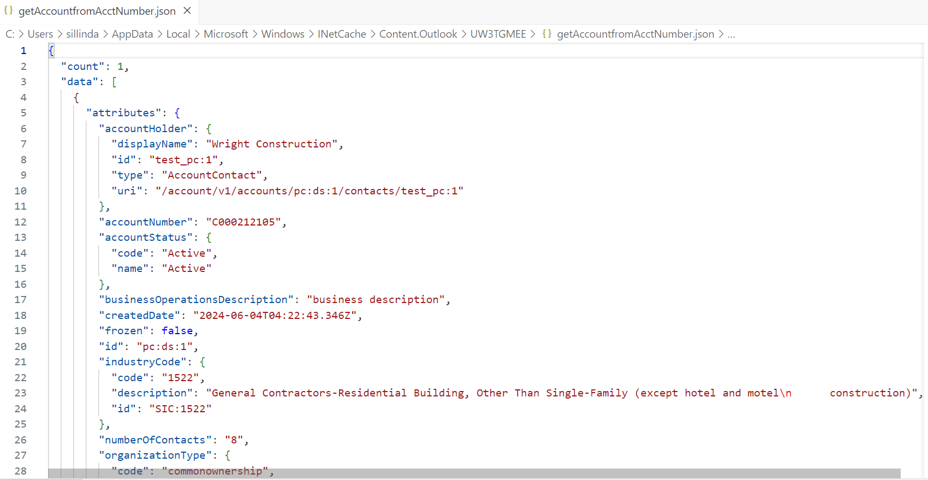
Customized API Testing with Playwright - 2
Purpose of this is to call customized API (Retrieve account API) and get response.
Flow Diagram:
Retrieve account API Request and Response JSONs:
Request :
Scenario : Retrieve Account from AcctID - Policy Center
Method : GET
Endpoint URL : http://localhost:8180/pc/rest/beazley/account/C000456354
Playwright
Request JSON
Response JSON:
Response JSON
Retrieve account API
GW Policy Center

Slide 7
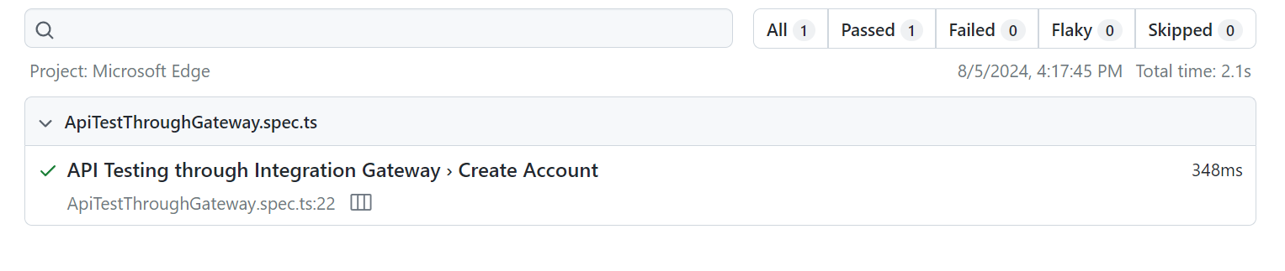
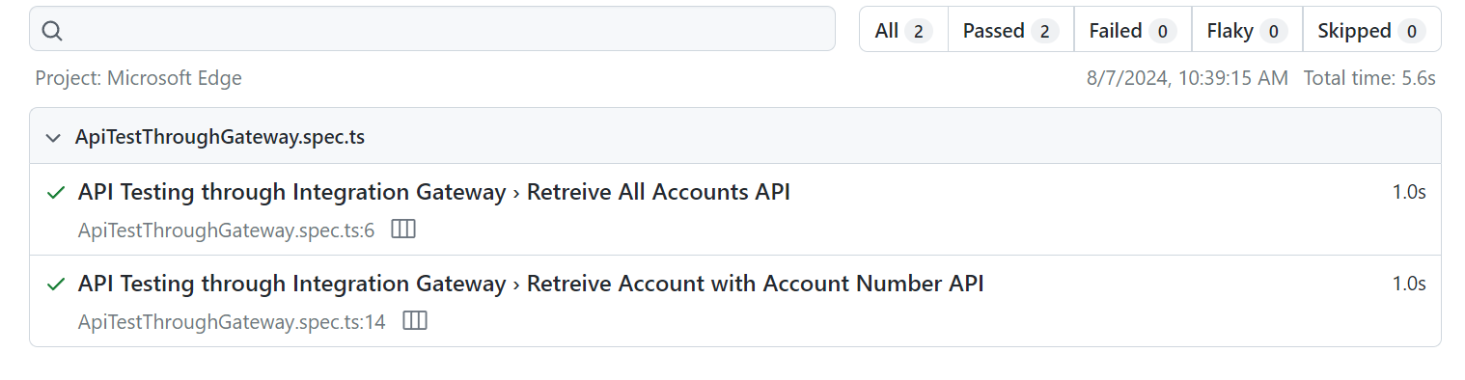
Cloud API Testing through Integration Gateway with Playwright - 1
Cloud API testing through Integration Gateway functions with Playwrite:
Create the account & Retrieve the account
(A custom cloud API has been developed in Integration Gateway. Playwright script was developed and executed to create an account, retrieve to view account summary through Integrated Gateway)
Execution Report:

Slide 8
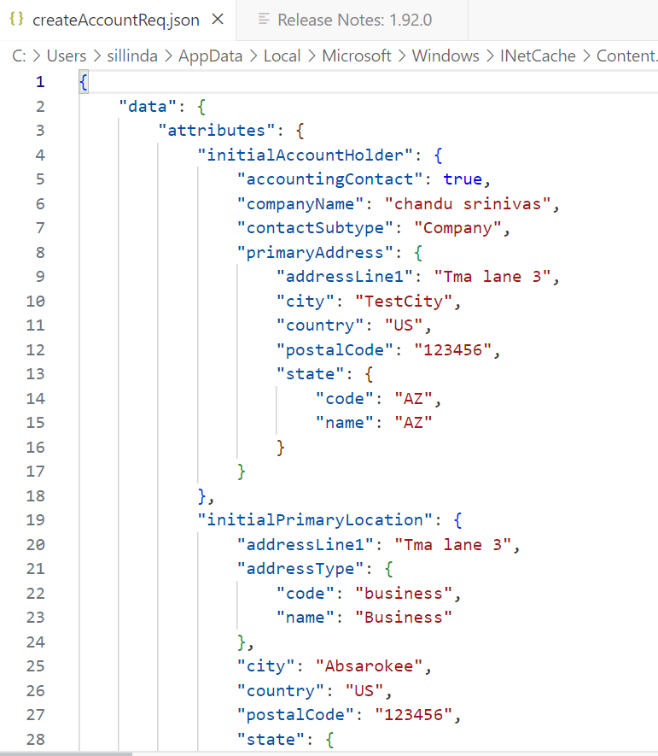
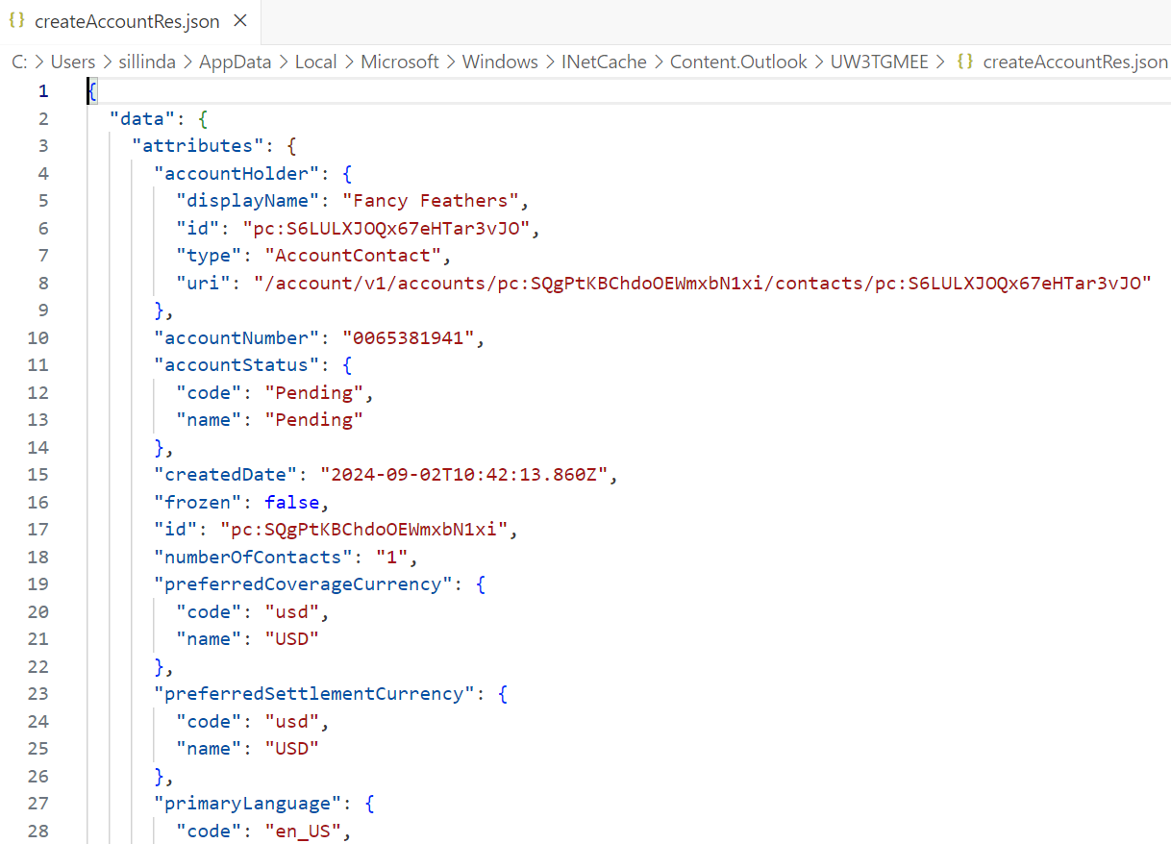
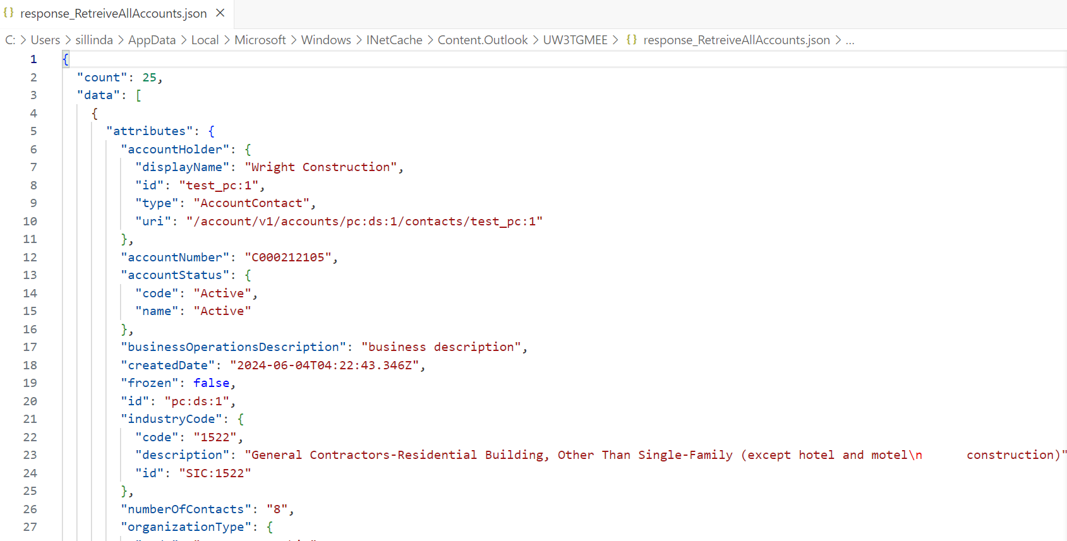
Cloud API Testing through Integration Gateway with Playwright - 2
Purpose of this is to call 2 customized APIs (Create account API & Retrieve account API) through Integration Gateway and get response.
Flow Diagram:
Create account API Request and Response JSONs:
Playwright
Response JSON
Response JSON
Request JSON
Request JSON
Integration Gateway
Create account API
Retrieve account API
Request JSON
Request JSON
Retrieve account Request and Response JSONs:
Response JSON
Response JSON
Scenario : Retrieve Account from AcctNumber - IG Server
Method : GET
Endpoint URL : http://localhost:8081/api/getAccountfromAcctNumber?accountNumber=C000456354
Create account API
Retrieve account API
GW Policy Center

Slide 9
Test Data Parameterization – From External Source (Excel)
Playwright can read from Excel sheet and populates the data into the application.
Test Scenarios :Account Creation
Test Data:

Slide 10
Tool comparison
Feature | Playwright | Selenium | GT Framework
Language Support | TypeScript, JavaScript, Python, .NET, Java | Java, C#, Ruby, Python, JavaScript | JavaScript, Test cafe, Node.js
Architecture | Chromium-based | Client-server | Built on Karate
Speed | Fast | Slow | Fast
Reporting | Built in Reports | Customizable | Customizable
Complexity | Moderate | High | Moderate
Debugging | Good | Challenging | Challenging
API Testing | Yes | Limited | Yes
Open Source | Yes | Yes | No

Slide 11
Pros and Cons
Advantages:
Playwright supports all major browsers: Chromium, Firefox and Webkit.
Supports different languages like: TypeScript, JavaScript, Python, .NET, and Java
It is designed to be Fast (similar timeline of 18 seconds is observed when compared to GTF for one sample scenario), Reliable (in terms of system hang or cracking the application etc) and Maintainable.
It has Auto-waits implementation which can eliminate usage of Explicit waits.
It can simulate different devices and screen sizes.
It Captures Video and Tracing for debugging.
It can execute multiple test Cases parallelly on multiple workers.
Limitations:
While Playwright is a powerful automation tool, it does have some limitations (From Beazley UWWB team context):
Excel spreadsheets are not allowed for data parametrization. We need to use JSON format only.
Limited knowledge and resources in the market.
Review process is very stringent and requires approval to merge the code.
Smaller Community: Compared to Selenium, Playwright has a smaller community, which might result in fewer resources and support.
Unavailability of Automation SPOC to make any quick decisions and to provide support from Beazley's side.

Slide 12
Conclusion
We were able to automate full policy life cycle with Playwright.
Able to do API testing.
Playwright POC has demonstrated significant potential for enhancing the test automation.

Slide 13
Appendix - 1
Playwright Overview
Key Features:
Cross-platform: Run tests on Windows, Linux, and macOS.
Cross-browser: Supports Chromium, Firefox, and WebKit.
Cross-language: Available in TypeScript, JavaScript, Python, .NET, and Java.
High performance: Executes tests rapidly and reliably.
Parallel Execution: Executes Test Cases Parallelly on multiple workers.
Modern web support: Handles modern web features like Web Workers, Service Workers, and more.
Auto-waiting: Eliminates the need for explicit waits.
Video and tracing: Captures test execution for debugging.
Mobile emulation: Simulates different devices and screen sizes.
Playwright: A Modern Automation Framework
Playwright is a powerful, open-source automation library that allows you to control Chromium, Firefox, and WebKit with a single API. It's designed to be fast, reliable, and maintainable.

Slide 14
Appendix - 2
Benefits of TypeScript
Type safety: Prevents runtime errors and improves code quality.
Code readability and maintainability: Enhances code structure and understanding.
Better tooling support: Leveraging advanced IDE features.
Large community and ecosystem: Access to libraries and resources.
By combining Playwright's automation capabilities with TypeScript's type safety and development features, you can create high-quality, efficient, and reliable test automation solutions.

Slide 15
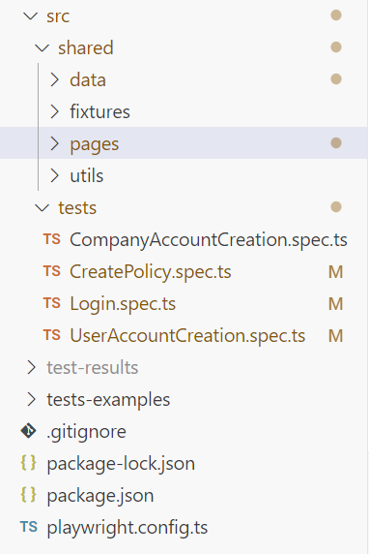
Appendix - 3
Folder Structure
Playwright and TypeScript together offer a powerful combination for building robust and maintainable automation test suites.
Folder Structure :
Source folder holds shared and Tests sub-folder which helps to organize Shared utilities and Test suits separately.
The 'Data' folder houses test data utilized in test cases. It accommodates test data in JSON or Excel file formats.
Fixtures are essential in Playwright for establishing a consistent and controlled environment for your tests. They handle the setup and teardown of resources required for each test, ensuring isolation and reliability.
Pages encapsulate web page-specific data, including element locators, page-related functions, and shared validation criteria.
The 'Utils' folder contains reusable functions shared across multiple pages.

